Slide 1
Introduction to Whole Genome Alignments
Fredj Tekaia
tekaia@pasteur.fr
Bioinformatics and Genome Analyses
Institut Pasteur Tunis, Tunisia. September 18 – December 15, 2017

Slide 2
Plan
• Why Whole genome alignments?
• What is expected from Who Genome Alignments?
• Short presentations of methods/algorithms used in genome alignments:
• Anchor-based approach
• Generate and test approach
• Suffix-tree approach
• Some programs and short introduction to their respective used algorithms:
MUMer/AVID/LAGAN/MLAGAN/MAUVE/BLASTZ
• References

Slide 3
Why Whole Genome Alignments? What is expected from WGA?
• Similarly to “standard” sequence alignments, aligning whole genome sequences will give hints about the evolutionary histories of the considered sequences.
• Standard alignments are concerned with conservation in whole or in parts between the considered sequences, their substitutions, insertions and deletions.
• Standard alignments may help in assessing the orthology and paralogy between sequences.

Slide 4
Why Whole Genome Alignments? What is expected from WGA?
The expectations from WGA are at the genome level:
• Orthologous regions between genomes
• Genome duplications (segmental or whole)
• Detection of syntenic chromosomal regions
• Segmental translocations, inversions and insertions
• Detection of repeated regions

Slide 5
Whole Alignment of two genomes
Translocation
Inversion
Insertion
B
A
B
• Synteny detection
• Genomic Repeats detection
http://cbcb.umd.edu/.../Lecture10_MUMmer_alignment.ppt
A

Slide 6
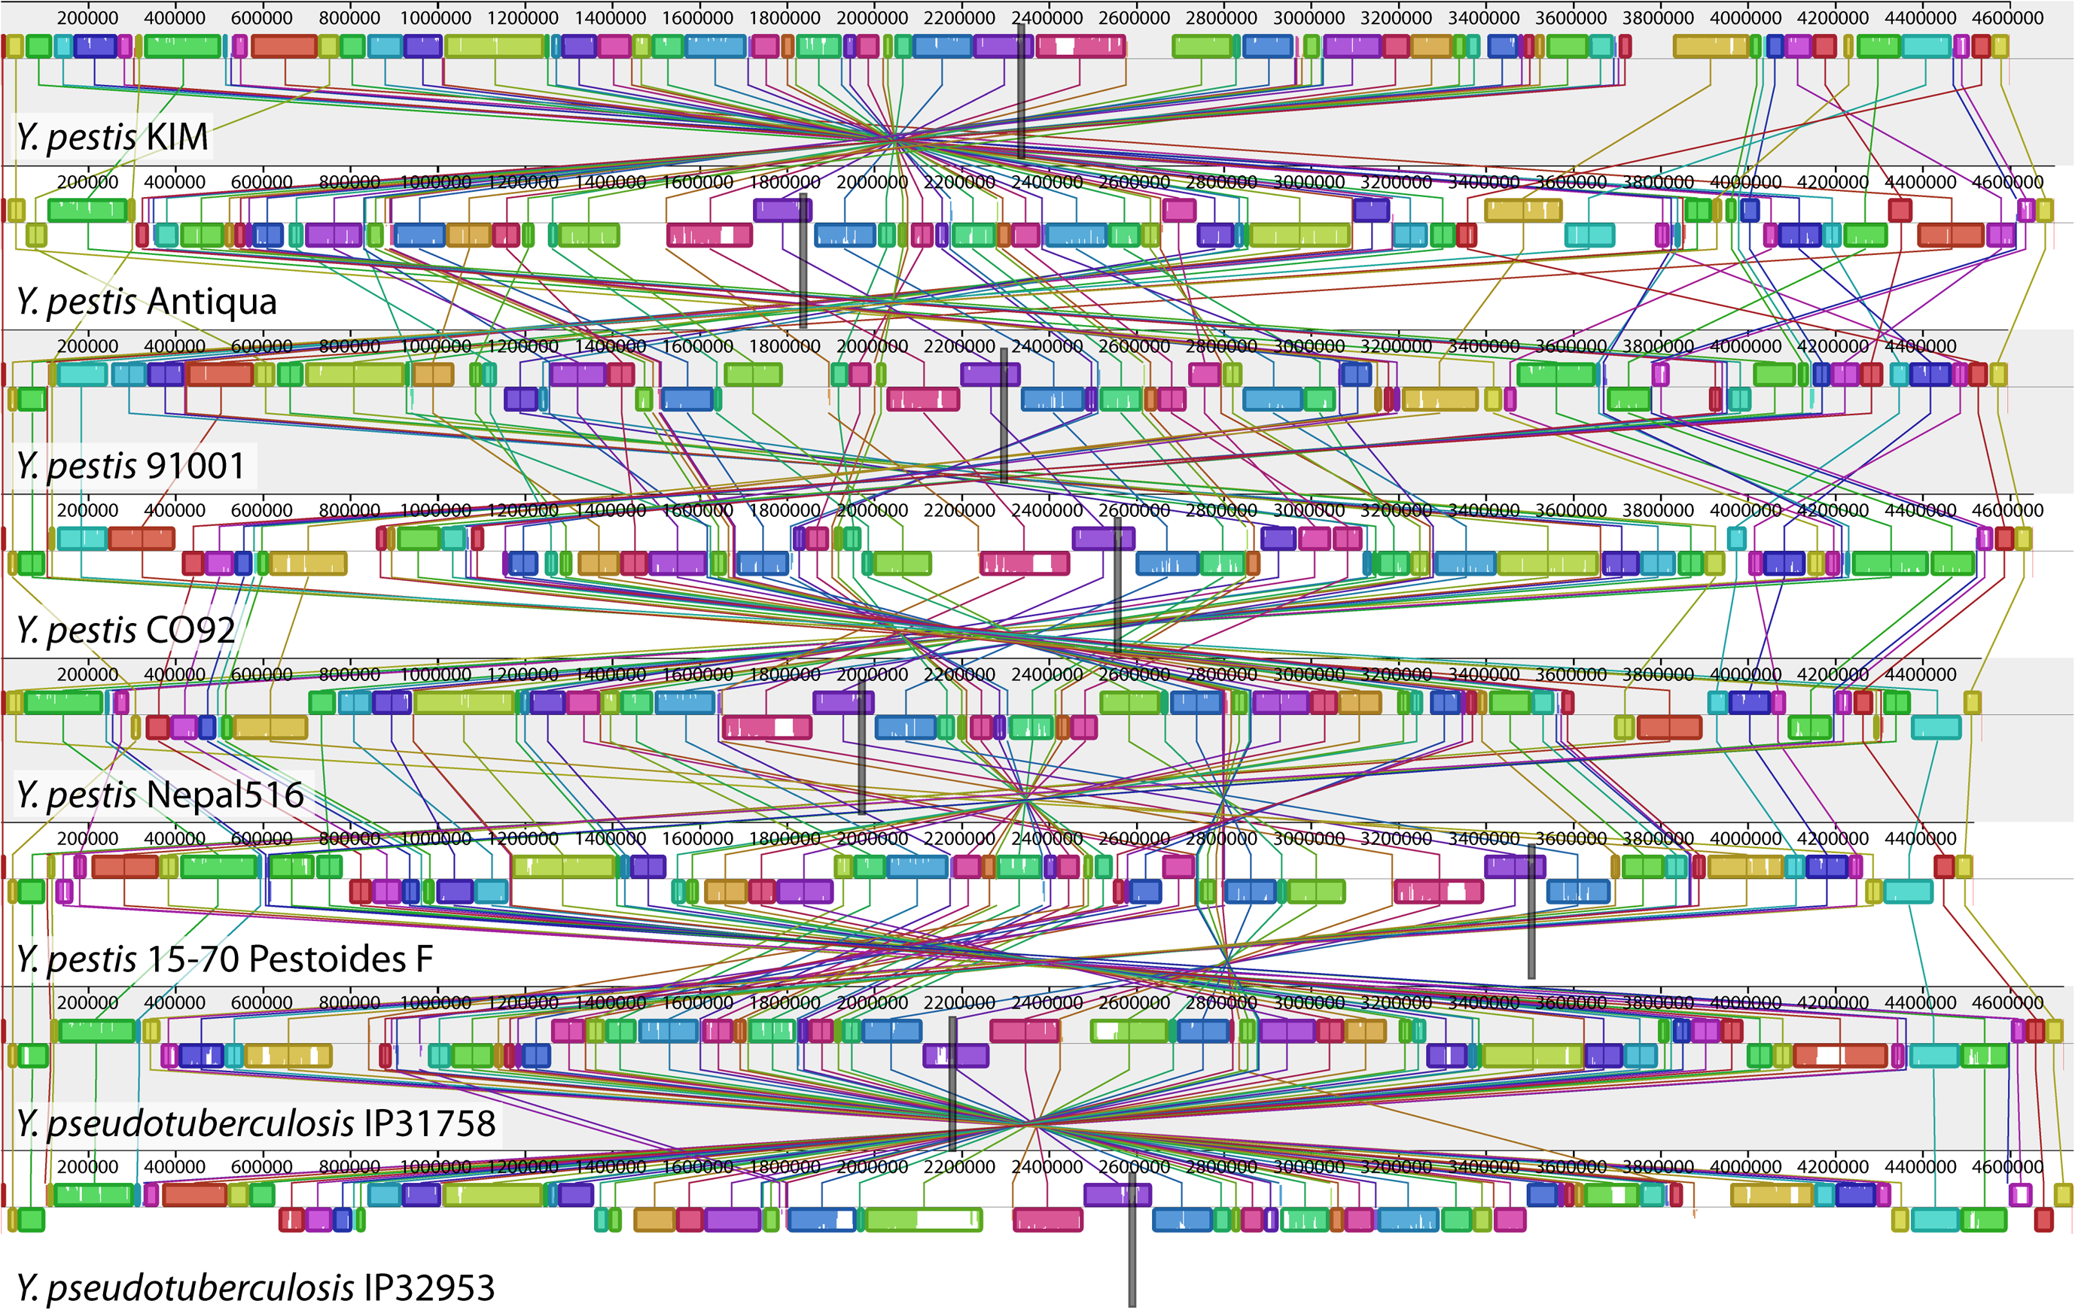
Example of Multiple whole genome alignments
Aaron E. Darling, Istvan Miklos, Mark A. Ragan (2008). Dynamics of Genome Rearrangement in Bacterial Populations. PLoS Genet. 2008 July; 4(7): e1000128.

Slide 7
Aligning genomes or large sequences
Compared to “standard” sequence alignments:
• Long sequences lead to memory problems;
• Speed becomes an issue,
• Long alignments are very sensitive to parameters,
• Accuracy is difficult to measure and to achieve.
Some existing programs:
MUMmer;
AVID; MAVID
BLASTZ,
LAGAN; MLAGAN; MAUVE

Slide 8
Aligning genomes of large sequences
There are 2 main approaches:
• Anchor based approach
• Suffix-tree based approach

Slide 9
Anchor-based approach
Most of genome alignment programs follow an anchor-based approach:
-computation of potential anchors;
-computation of a collinear sequence of non-overlapping potential anchors;
These anchors form the basis of the alignment and alignment of the gap in between the anchors.

Slide 10
Generate-and-test approach
To compute potential anchors, i.e., maximal matches of some length l or longer, use a generate-and-test approach:
• all matches of length k<l, called k-mers, are generated using a method based on hashing.
• Each such k-mer is checked to see whether it can be extended to a maximal exact match of length at least l.
• The extension is done by pairwise character comparisons, and thus the run time of this approach depends not only on the number of possible anchors, but also on their lengths.
➔For this reason the generate-and-test approach leads to long running times, if the sequences under consideration share long substrings;

Slide 11
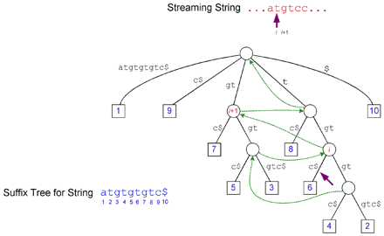
Suffix trees
Definition: a suffix tree T for a string S of length m is a rooted directed tree with exactly m leaves numbered 1 to m.
Each internal node, excluding the root, has at least two leaves labelled with substrings of S starting with different characters.
Concatenation of edge-labels from the root to the leaf i identify the suffix of S starting at position i.
A suffix tree is a data structure for representing all the substrings of a string.
Delcher et al. 2002. NAR 30:2478.
Notes:
Les numéros des noeuds terminaux n correspondent aux positions sur le string commencant à la position de même
numéro n.

Slide 12
Suffix trees approach
A suffix tree for a string S of length n can be represented in space proportional to n.
Given the suffix tree of S and a query string Q of length m, there are algorithms to compute all unique maximal matches between S and Q of any specified minimum length (the potential anchors) in time proportional to m.
Note that unlike the hashing approaches, the run-time of the suffix-tree algorithms does not depend on the length of the maximal matches.

Slide 13
MUMer
• MUMmer (Maximal Unique Matcher)
http://mummer.sourceforge.net/

Slide 14
The MUMmer System approach
Given 2 genomes A and B:
-find all maximal, unique, matching sub-sequences (MUMs),
-extract the longest possible set of matches that occur in the same order in both genomes,
-close gaps,
-output alignment
• Delcher et al. NAR, 1999,
• Kurtz et al. Genome Biology, 2004;

Slide 15
Features Identified by MUMmer
• Single Nucleotide Polymorphisms (SNPs)
• Regions of divergence > 1 SNP
• large inserts
• repeats
• tandem repeats: 2 or more adjacent, approximate copies of a DNA pattern

Slide 16
Finding matches
• Build suffix tree;
• Finding maximal matches in linear time by building a tree from k sequences;
• Sort the matches by length and local similarity for purpose of finding anchors

Slide 17
MUMs and Suffix Trees
• The key idea in identifying MUMs is to build a suffix tree for genomes A and B.
• Add suffixes for both genomes A and B to tree;
• Label each leaf node with genome it represents.
Genome A: ccacg#
12345
acg#
c
t$
g$
A,5
B,3
A,3
acg#
c
g$
t$
Genome B: cct$
123
A,2
A,4
B,2
acg#
t$
A,1
B,1

Slide 18
MUMs and Suffix Trees
• a unique match: internal node with 2 children as leaf nodes from different genomes;
• these matches are not necessarily maximal
Genome A: ccacg#
acg#
c
t$
Genome B: cct$
g$
A,5
B,3
A,3
acg#
c
g$
t$
A,2
A,4
B,2
acg#
t$
represents unique match
A,1
B,1

Slide 19
Algorithm of AVID
http://www-gsd.lbl.gov/vista
• Order and orient,
• Find all the maximal matches,
• Align the maximal matches,
• Fix matches with good local similarity,
• Refine with shorter matches.

Slide 20

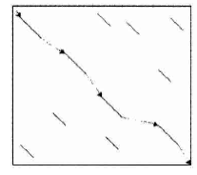
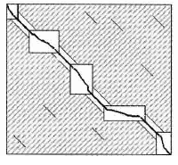
Whole genome alignments
LAGAN
Multi-LAGAN
http://lagan.stanford.edu/lagan_web/index.shtml
Three main steps:
1.Generation of local alignments (anchors).
2. Construction of a rough global map.
3. Computation of the final global alignment.
Michael Brudno, et al. (2003). LAGAN and Multi-LAGAN: efficient tools for large-scale multiple alignment of genomic DNA, Genome Research 2003 Apr;13(4):721-31.

Slide 21
LAGAN – Multi-LAGAN
http://lagan.stanford.edu/lagan_web/about.shtml
The LAGAN Toolkit consists of four components:
CHAOS CHAOS is a pairwise local aligner optimized for non-coding, and other poorly conserved regions of the genome. It uses both exact matching and degenerate seeds, and is able to find homology in the presence of gaps.
LAGAN LAGAN is a highly parametrisable pairwise global alignment program. It takes local alignments generated by CHAOS as anchors, and limits the search area of the Needleman-Wunsch algorithm around these anchors;
Michael Brudno, et al. (2003). LAGAN and Multi-LAGAN: efficient tools for large-scale multiple alignment of genomic DNA, Genome Research 2003 Apr;13(4):721-31.

Slide 22
LAGAN – Multi-LAGAN
Multi-LAGAN Multi-LAGAN is a generalization of the pairwise algorithm to multiple sequence alignment. M-LAGAN performs progressive pairwise alignments, guided by a user-specified phylogenetic tree. Alignments are aligned to other alignments using the sum-of-pairs metric.
Shuffle-LAGAN Shuffle-LAGAN is a novel glocal alignment algorithm that is able to find rearrangements (inversions, transpositions and some duplications) in a global alignment framework. It uses CHAOS local alignments to build a map of the rearrangements between the sequences, and LAGAN to align the regions of conserved synteny.

Slide 23

http://darlinglab.org/mauve/mauve.html
Mauve is a system for constructing multiple genome alignments in the presence of large-scale evolutionary events such as rearrangement and inversion.
See introduction:
http://darlinglab.org/mauve/user-guide/introduction.html

Slide 24
MAUVE
Anchored alignment
Like many other genome alignment methods, Mauve uses the anchored alignment technique to rapidly align genomes.
Finding anchors
The current Mauve release uses inexact, un-gapped matches as alignment anchors.
The inexact matches are found using a seed-and-extend method, where each seed match conforms to a pattern of matching nucleotides.
• Mauve extends the pairwise seed matching paradigm to match multiple sequences simultaneously under the constraint that any seed must be unique in each genome.

Slide 25
MAUVE
Selecting Locally Collinear Blocks (LCBs)
• Among the initial set of anchors identified by Mauve, some will be random matches (typically small insignificant genome rearrangements) that should not be included in the correct genome alignment.
• In order to identify and discard such matches, Mauve requires that each collinear region of the alignment meets a “minimum weight” criteria.
• The weight of an LCB is defined as the sum of the lengths of matches in that LCB.
• Mauve removes matches composing low-weight LCBs from the set of alignment anchors before completing the alignment.

Slide 26
MAUVE
Finishing the alignment
Once a set of alignment anchors that define Locally Collinear Blocks have been determined, Mauve completes a gapped global alignment of each LCB.
Mauve applies the ClustalW or MUSCLE progressive global alignment algorithms to each LCB.

Slide 27
Pair-wise genome sequence alignment
• BLASTZ :
http://genomewiki.ucsc.edu/index.php/Blastz
blastz is an improvement of gapped blastn program:
• Find short exact matches,
• Determine ungapped extensions of the exact matches,
• For sufficiently high-scoring ungapped matches, compute alignments allowing for gaps.
blastz was used to align human-mouse genomes.
Chiaromonte et al. (2002).

Slide 28
Genome aligners
AVID: http://www-gsd.lbl.gov/vista/details_avid.htm
BLASTZ: http://bio.cse.psu.edu
BLAT: http://genome.ucsc.edu
Exonerate: http://www.ensembl.org/Docs/wiki/html/EnsemblDocs/Exonerate.html
GLASS: http://crossspecies.lcs.mit.edu
LAGAN/MLAGAN: http://lagan.stanford.edu
MegaBLAST: http://www.ncbi.nih.gov/blast/tracemb.html
MUMmer: http://www.tigr.org/software/mummer
PatternHunter: http://www.bioinformaticssolutions.com/products/ph.php
WABA: http://www.cse.ucsc.edu/~kent/xenoAli/index.html
Whole-genome alignments in genome browser
ECR browser: http://nemo.lbl.gov/ecrBrowser
Ensembl:http://www.ensembl.org
UCSC:http://genome.ucsc.edu
Pipmaker (pdf output only):
http://bio.cse.psu.edu/pipmaker
VISTA-based: http://pipeline.lbl.gov
WormBase: http://www.wormbase.org
Abel Ureta-Vidal, Laurence Ettwiller & Ewan Birney (2003) Nature review. 4, 251-262.

Slide 29
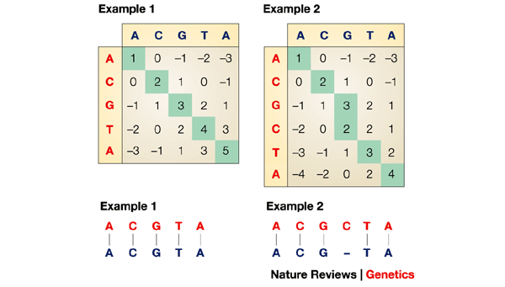
Reminder: Dynamic Programming (DP)
Dynamic programming (DP) is a method for breaking down the alignment of sequences into small parts, which considers all the possible changes in moving from one pair of characters in the alignment to the next. It is comparable to moving across a DOT PLOT MATRIX and keeping track of all the matching pairs, adding up those pairs that are found along a diagonal and making a subtraction when insertions are necessary to maintain an alignment. In this simple example, a match is scored as 1, a mismatch is scored as -1 and an insertion/deletion gap penalty is scored as
-1. Alignments are easily produced by finding the highest score, then tracing back through the matrix that has previously been defined.

Slide 30
References
• BLASTZ :
S. Schwartz, et al. (2003). Human-Mouse Alignments with BLASTZ. Genome Research, 2003; 13: 103–107
• Chiaromonte F, Yap VB, Miller W. (2002). Scoring pairwise genomic sequence alignments. chiaro@stat.psu.edu Pac Symp Biocomput. 2002:115-26.
• LAGAN : http://lagan.stanford.edu/lagan_web/lagan.shtml
http://lagan.stanford.edu/lagan_web/index.shtml
• MLAGAN : http://lagan.stanford.edu/cgi-bin/MLaganInput.cgi
• WABA : http://www.cse.ucsc.edu/~kent/xenoAli/index.html
• Delcher et al. NAR, 1999.
• Kurtz et al. Genome Biology, 2004;
• Abel Ureta-Vidal, Laurence Ettwiller & Ewan Birney (2003) Nature review. 4, 251-262. Comparative genomics: genome-wide analysis in metazoan eukaryotes

Slide 31
Thank You

